Slide 1

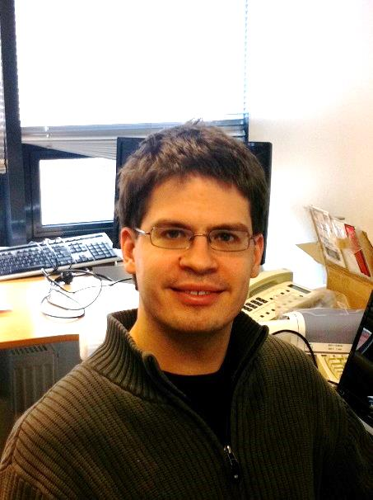
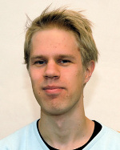
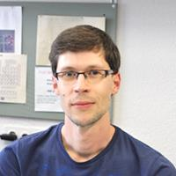
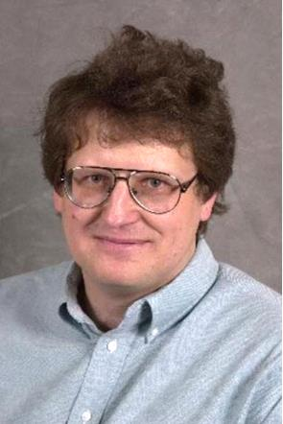
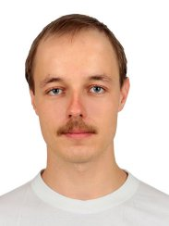

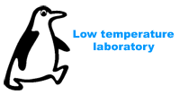
Maxwell's Demon in a circuit - refrigerator powered by information
Jukka Pekola, Low Temperature Laboratory
Aalto University, Helsinki, Finland
Takahiro Sagawa, Tapio Ala-Nissila, Aki Kutvonen, Dmitry Golubev
Jonne Koski
Olli-Pentti Saira
Ville Maisi,
also CPH
Dmitri Averin, SUNY
Ivan Khaymovich, CNRS

Slide 2
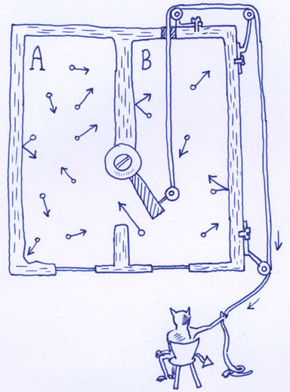


Outline and motivation
Heat management at nanoscale, refrigerators
Maxwell’s demon
Experiment on a single-electron Szilard’s engine
Experiment on an autonomous Maxwell’s demon
Quantum heat engines
Calorimetry for quantum circuits
Basics of thermodynamics:
The role of information in thermodynamics?
Reviews: Lutz, Ciliberto, Physics Today 68, 30 (2015); JP, Nature Physics 11, 118 (2015).

Slide 3
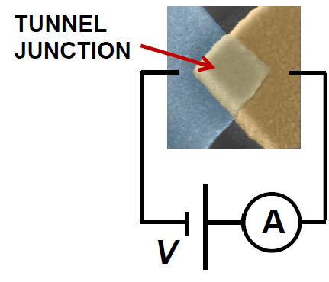
Dissipation in transport through a barrier
μ₁
Dissipation generated by a tunneling event in a junction biased at voltage V
E
ΔU
μ₂
ΔQ = (μ₁-E)+(E-μ₂) = μ₁-μ₂ = eV
ΔQ = TΔS is first distributed to the electron system, then typically to the lattice by electron-phonon scattering
For average current I through the junction, the total average power dissipated is naturally
P = (I/e)ΔQ = IV

Slide 4
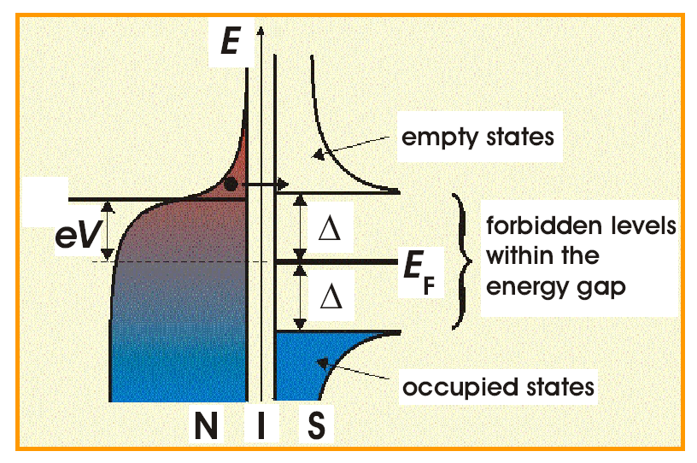
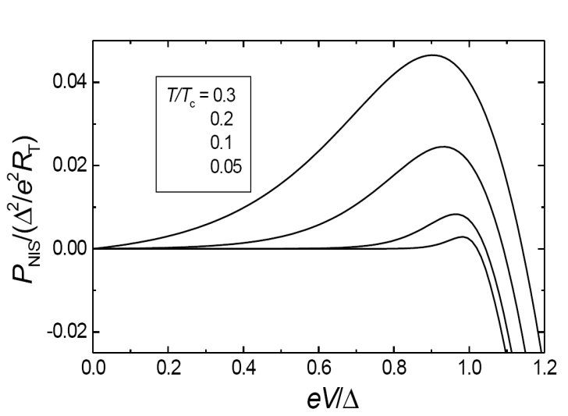
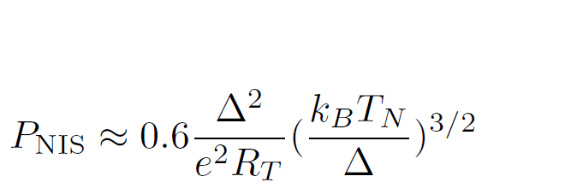
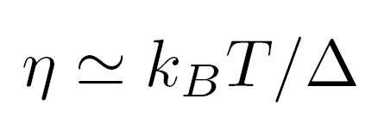
Electronic coolers
Cooling power of a NIS junction:
Optimum cooling power is reached at V ≅ Δ/e:
Efficiency (coefficient of performance) of a NIS junction cooler:
For reviews, see Rev. Mod. Phys. 78, 217 (2006); Reports on Progress in Physics 75, 046501 (2012).

Slide 5
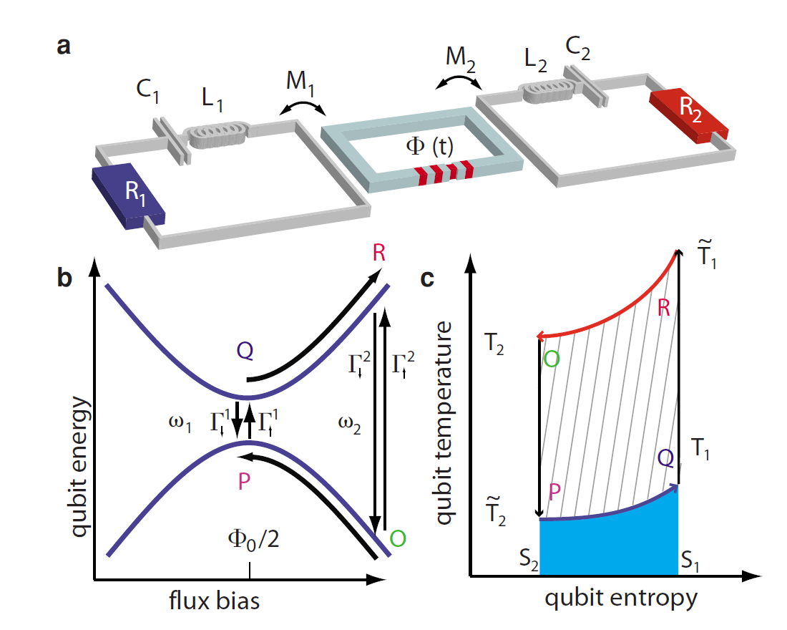
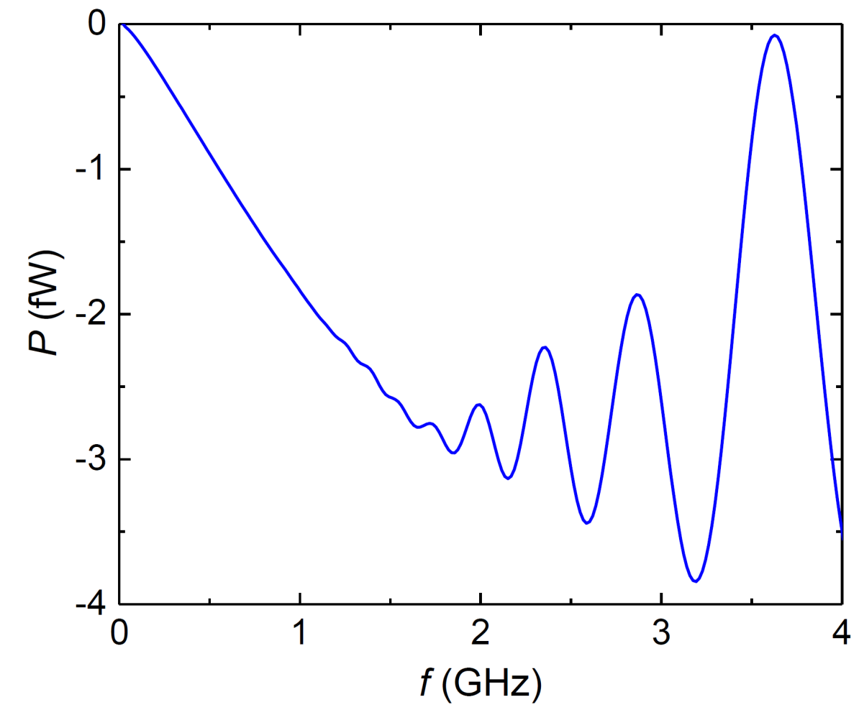
Quantum heat engine
Niskanen, Nakamura, Pekola, PRB 76, 174523 (2007)
B. Karimi and JP, 2016

Slide 6
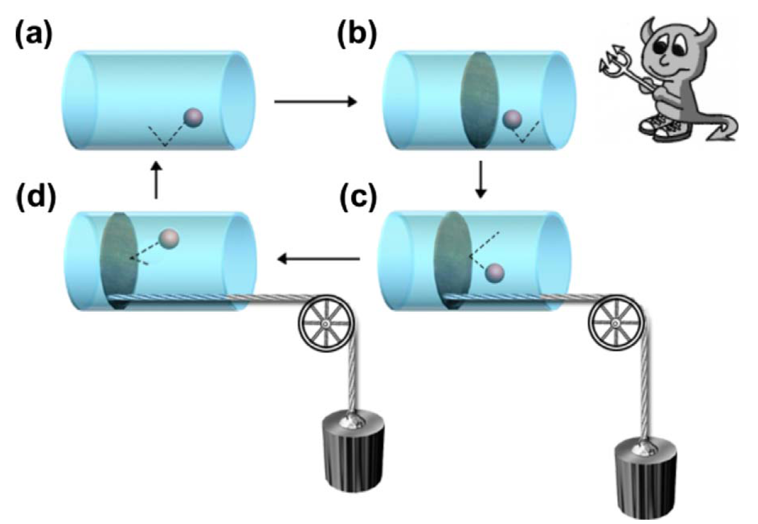
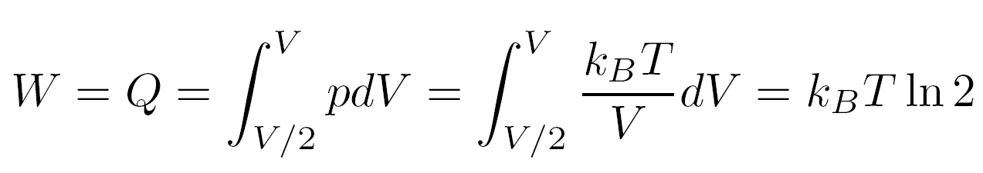
Information-powered cooling: Szilard’s engine
(L. Szilard 1929)
Figure from Maruyama et al., Rev. Mod. Phys. 81, 1 (2009)
Isothermal expansion of the ”single-molecule gas” does work against the load

Slide 7
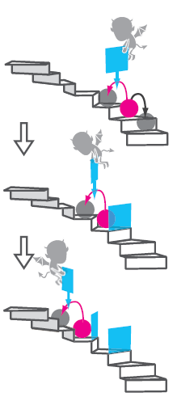
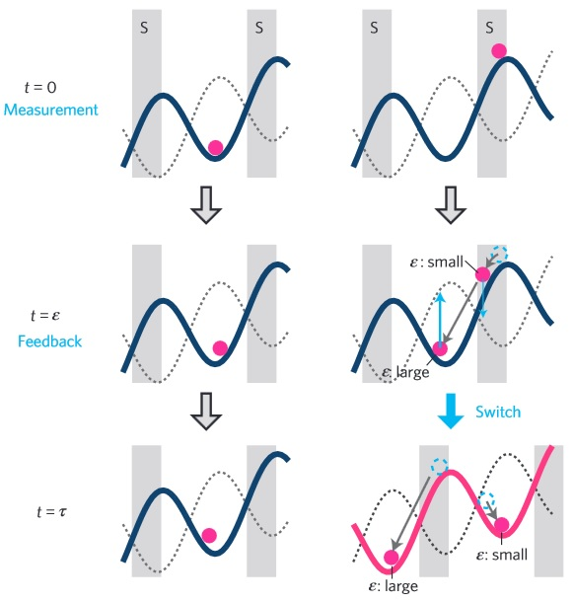
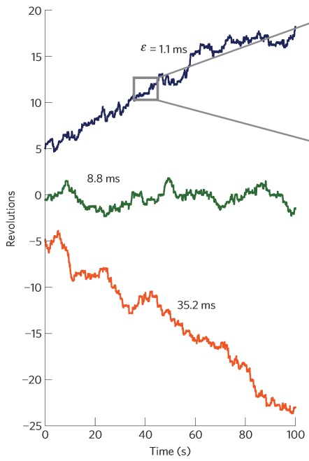
Experiments on Maxwell’s demon
S. Toyabe, T. Sagawa, M. Ueda, E. Muneyuki, M. Sano, Nature Phys. 6, 988 (2010)
É. Roldán, I. A. Martínez, J. M. R. Parrondo, D. Petrov, Nature Phys. 10, 457 (2014)

Slide 8
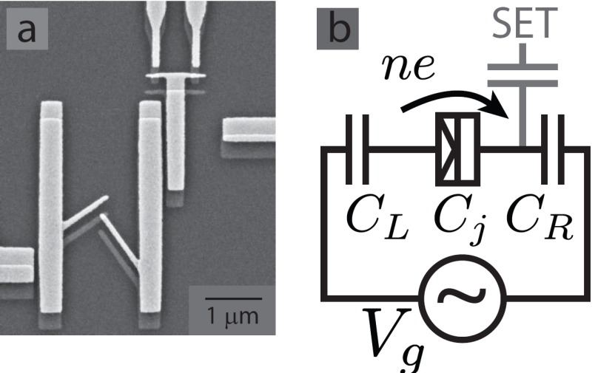

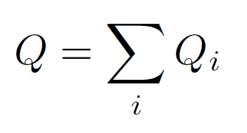



Dissipation and work in single-electron transitions
Heat generated in a tunneling event i:
Total heat generated in a process:
Work in a process:
n
n = 0
n = 1
Change in internal (charging) energy
D. Averin and JP, EPL 96, 67004 (2011)

Slide 9
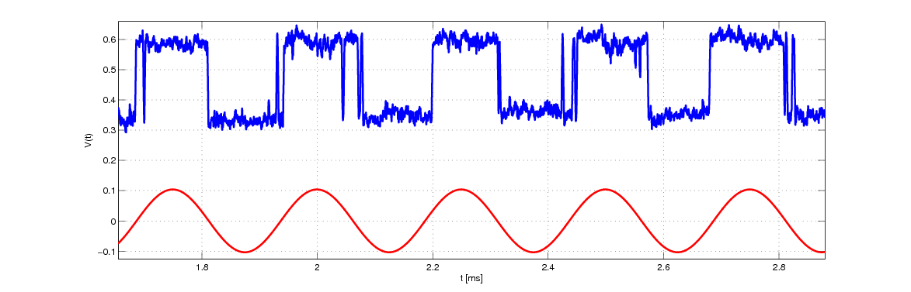
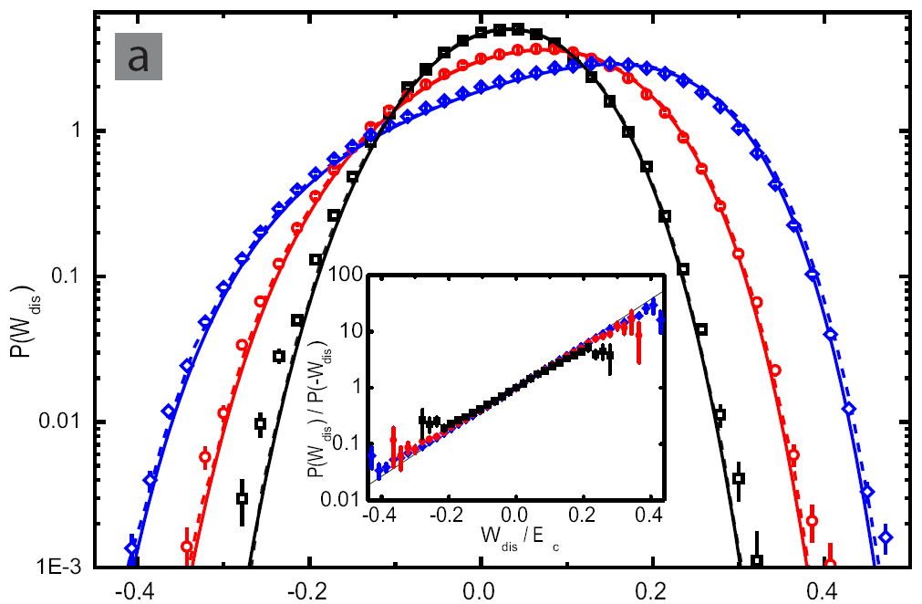
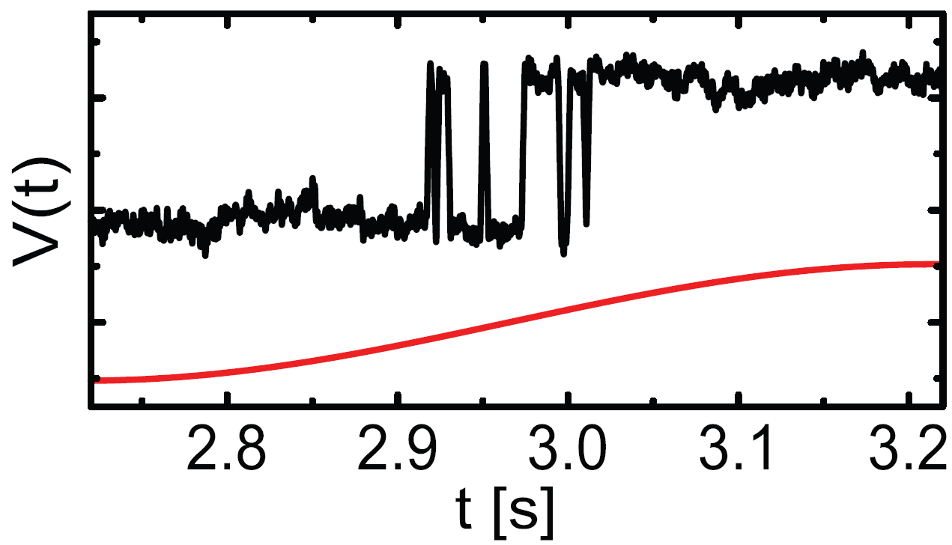

Experiment on a single-electron box
O.-P. Saira et al., PRL 109, 180601 (2012); J.V. Koski et al., Nature Physics 9, 644 (2013).
.
Detector current
Gate drive
TIME (s)
P(W_{d})
P(W_{d})/P(-W_{d})
W_{d} /E_{C}
The distributions satisfy Jarzynski equality:
W_{d} /E_{C}

Slide 10
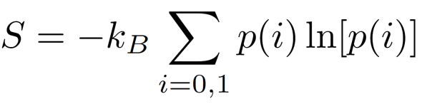


Szilard’s engine for single electrons
J. V. Koski et al., PNAS 111, 13786 (2014); PRL 113, 030601 (2014).
Entropy of the charge states:
Measurement
Quasi-static drive
Fast drive after the decision
In the full cycle (ideally):

Slide 11
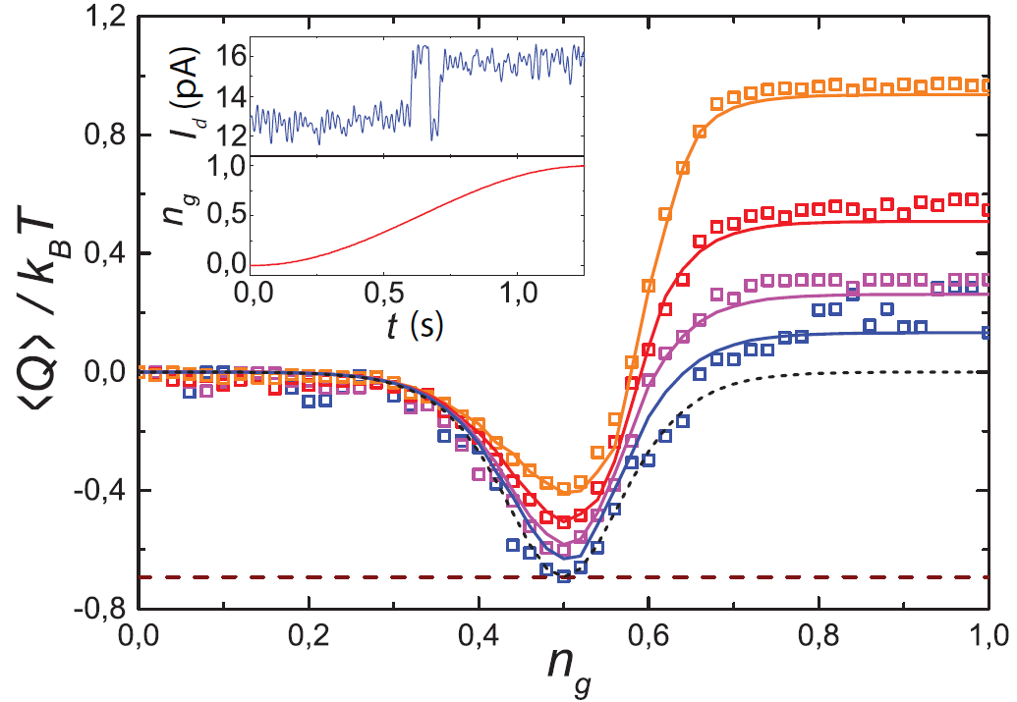
Extracting heat from the bath
Decreasing ramping rate
- k_{B}T ln(2)

Slide 12
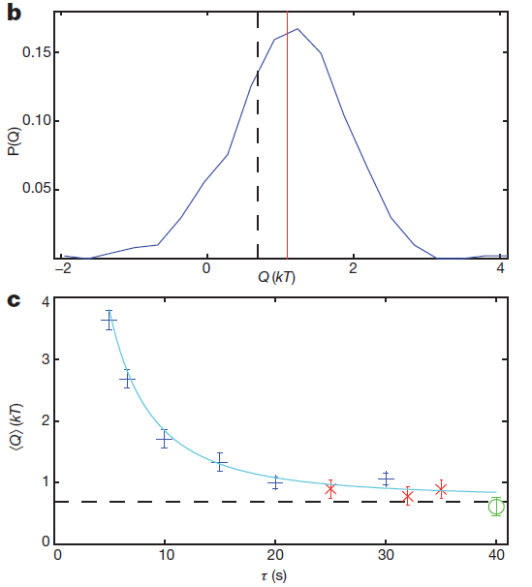
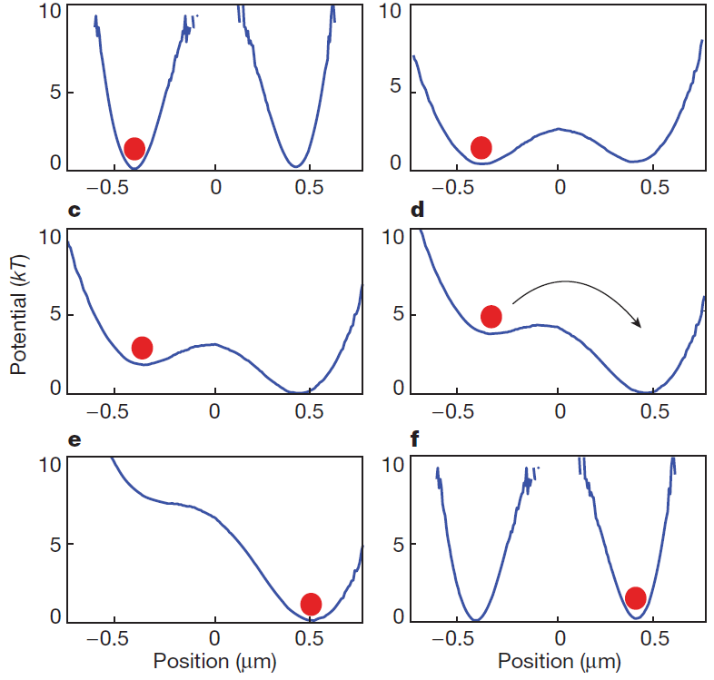
Erasure of information
Landauer principle: erasure of a single bit costs energy of at least k_{B}T ln(2)
Experiment on a colloidal particle:
A. Berut et al., Nature 2012
Corresponds to our experiment:
- k_{B}T ln(2)

Slide 13
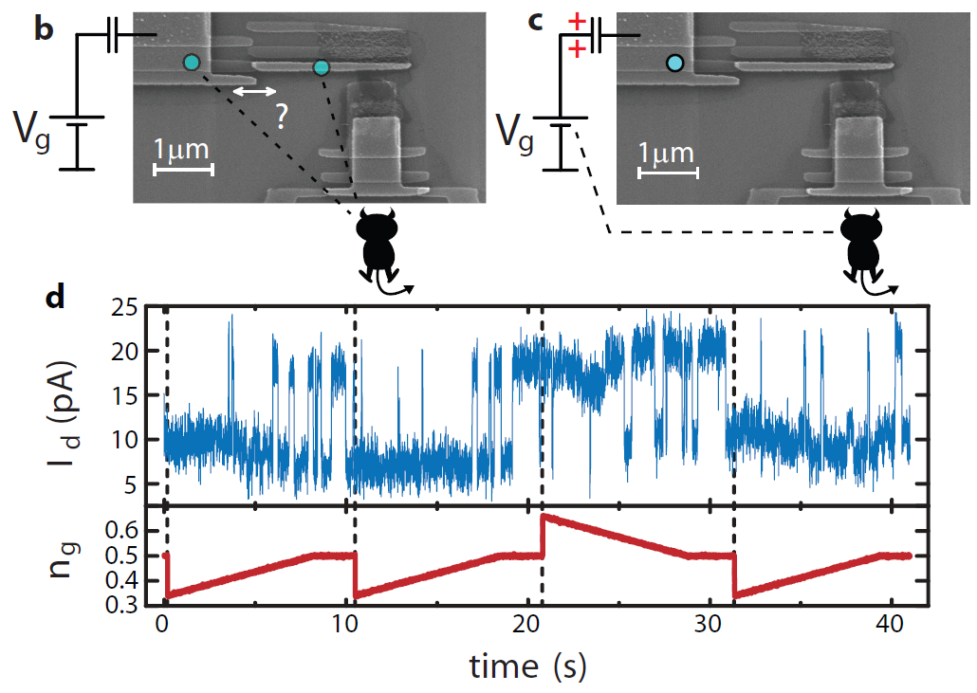
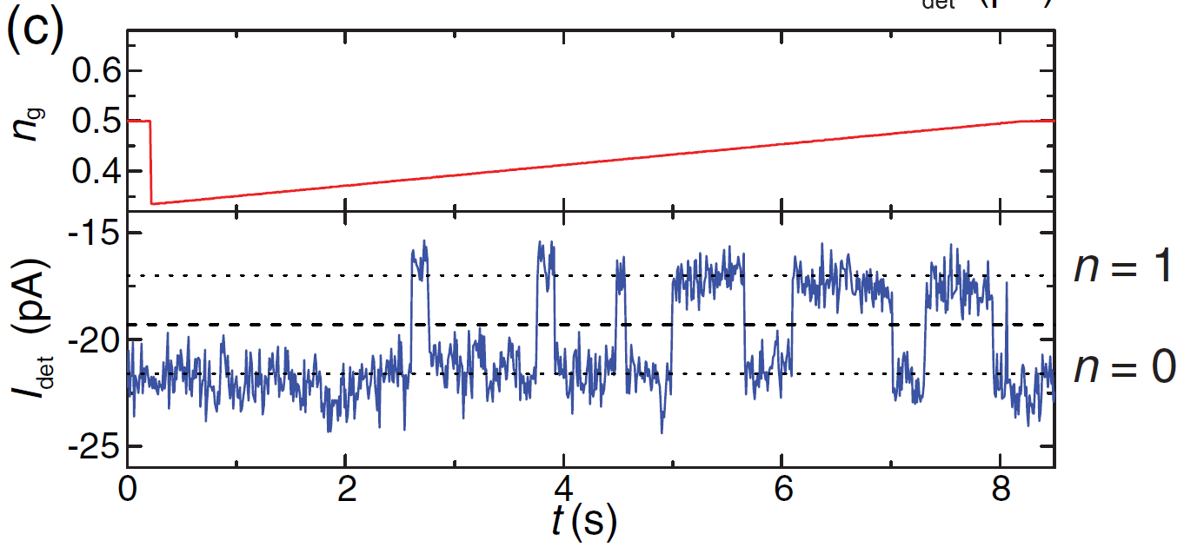
Realization of the MD with an electron
Measurement and decision
Quasi-static ramp
GATE VOLTAGE
CHARGE STATES

Slide 14
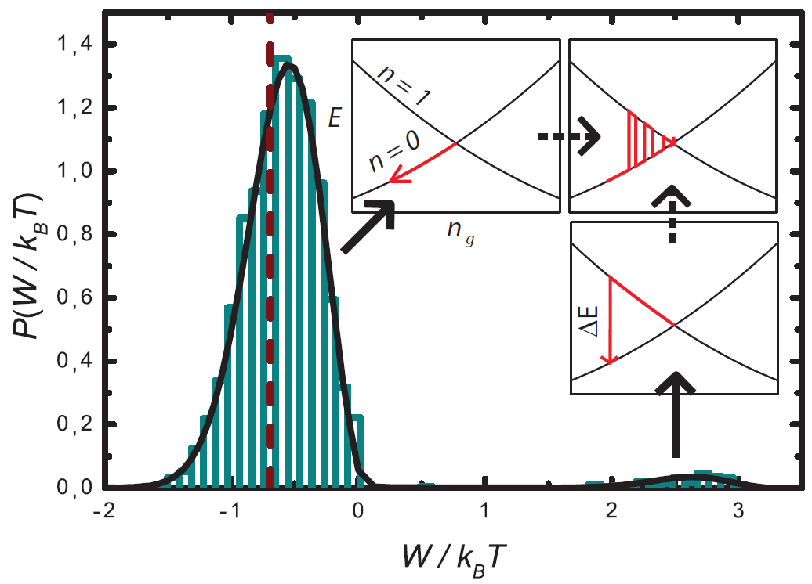

Measured distributions in the MD experiment
Whole cycle with ca. 3000 repetitions:
- ln(2)
J. V. Koski et al., PNAS 111, 13786 (2014)

Slide 15

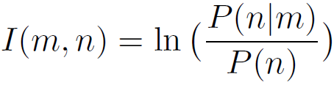
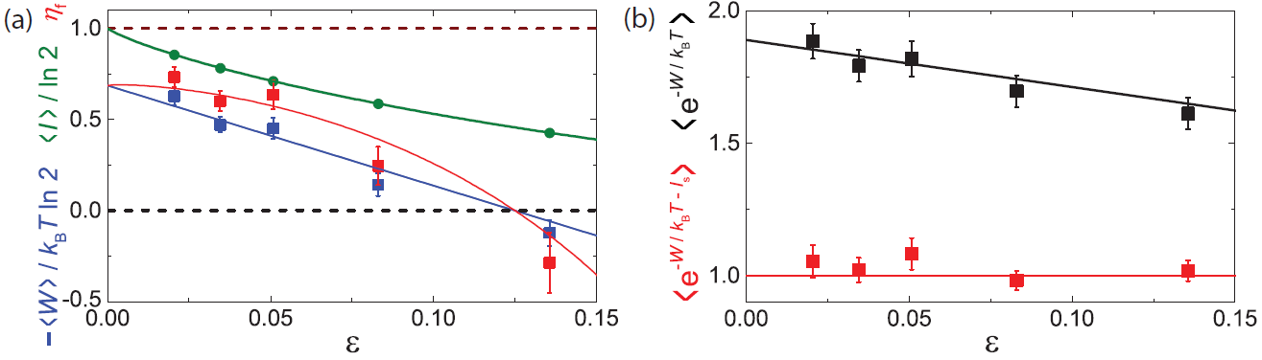
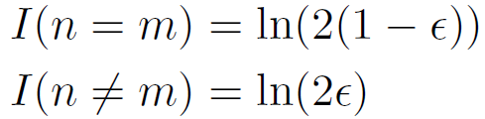
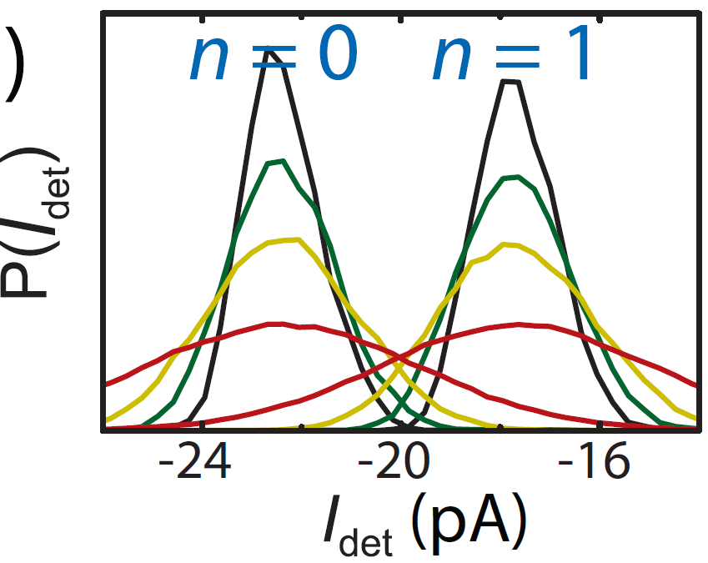
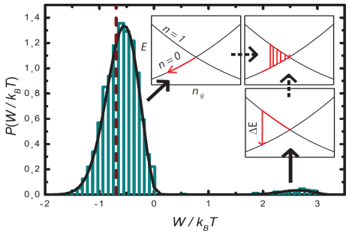
Sagawa-Ueda relation
T. Sagawa and M. Ueda, PRL 104, 090602 (2010)
For a symmetric two-state system:
Measurements of n at different detector bandwidths
J. V. Koski et al., PRL 113, 030601 (2014)

Slide 16
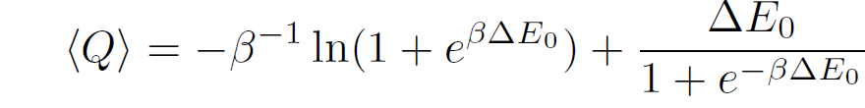
Maxwell’s Demon based on a Single Qubit
FAST SWEEP (RESET)
ADIABATIC SWEEP
π-PULSE
ΔE_{A}
ΔE₀
MEASUREMENT
X
X
A
NO PULSE
A
-1/2
0
1/2
q
Ideally
J. P. Pekola, D. S. Golubev, and D. V. Averin, PRB 93, 024501 (2016)

Slide 17
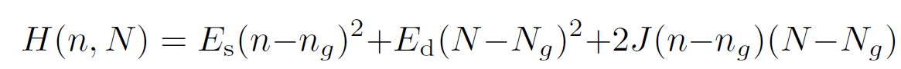
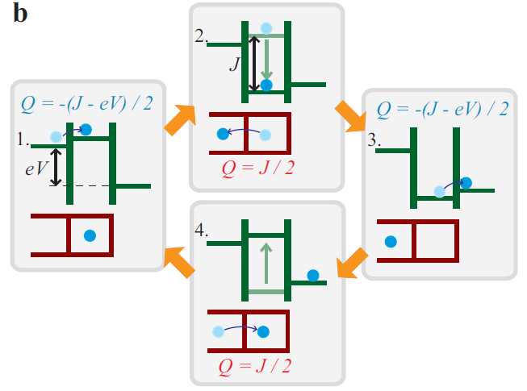
Autonomous Maxwell’s demon
System and Demon: all in one
Realization in a circuit:
J. V. Koski, A. Kutvonen, I. M. Khaymovich, T. Ala-Nissila, and JP, PRL 115, 260602 (2015).
Similar idea: P. Strasberg et al., PRL 110, 040601 (2013).
U_{g}
n_{g}, n
V
N_{g}, N
V_{g}

Slide 18
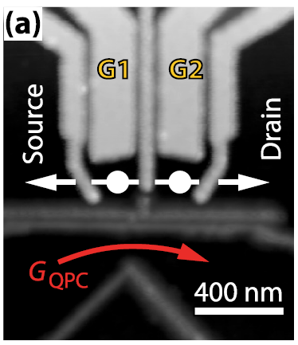
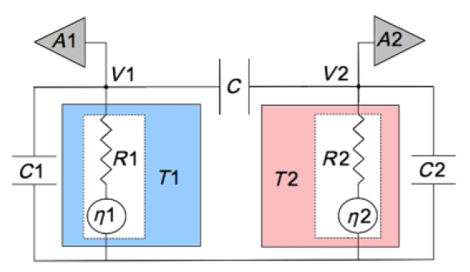
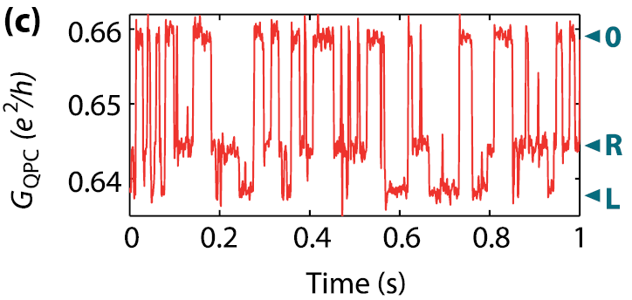


Work and heat in small systems: experimental situation
Typically an indirect measurement, hinging on understanding the system sufficiently well
Q = neV_{DS}
Y. Utsumi et al. PRB 81, 125331 (2010), B. Kung et al. PRX 2, 011001 (2012)
S. Ciliberto et al., PRL 110, 180601 (2013)

Slide 19
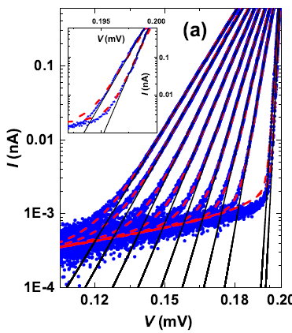
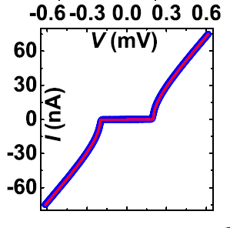
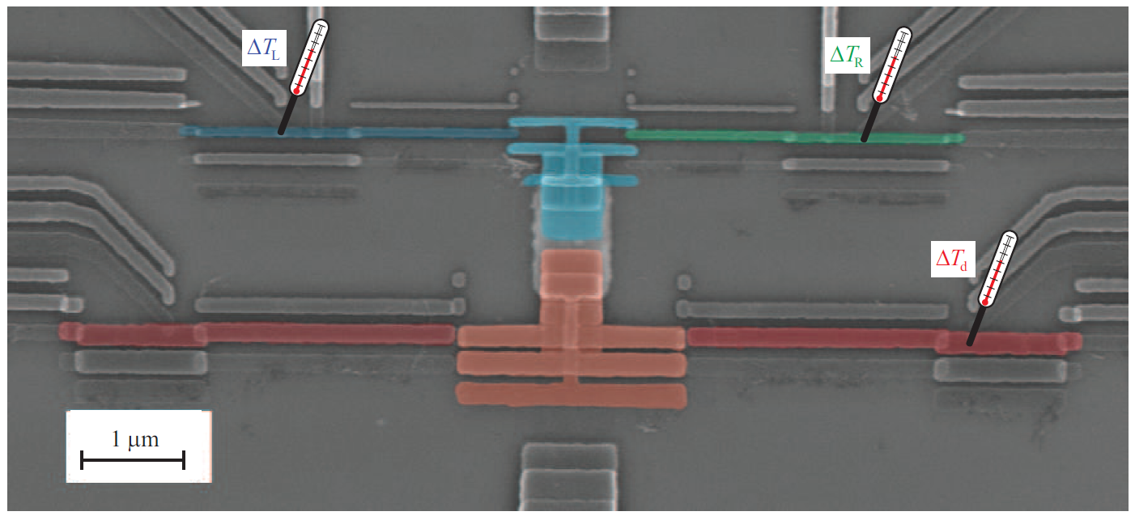
Autonomous Maxwell’s demon – information-powered refrigerator
Thermometers based on standard NIS tunnel junctions
Image of the actual device
R_{s} ~ 580 kΩ
E_{C}¹ ~ 150 μeV
R_{s} ~ 580 kΩ
E_{C}² ~ 72 μeV
R_{d} ~ 85 kΩ
A. V. Feshchenko et al., Phys. Rev. Appl. 4, 034001 (2015).

Slide 20
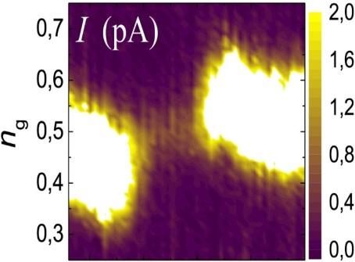
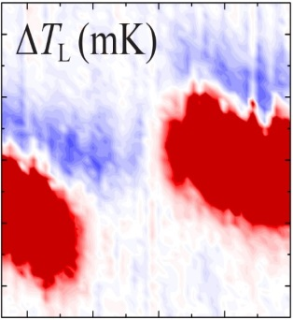
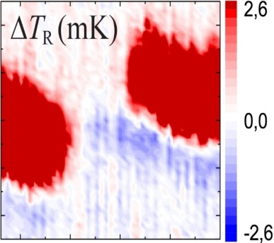
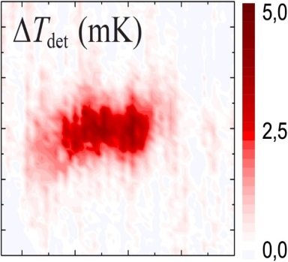
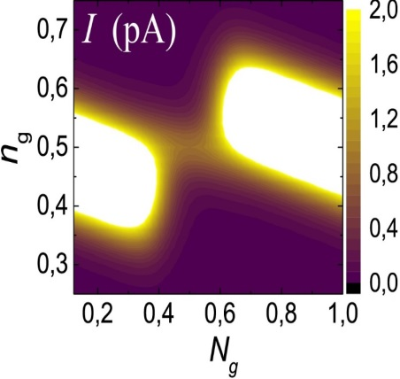



Current and temperatures at different gate positions
U_{g}
n_{g}, n
T_{L}
T_{R}
V
I
T_{det}
N_{g}, N
V_{g}
V = 20 μV, T = 50 mK

Slide 21






N_{g} = 1: No feedback control (”SET-cooler”)
JP, J. V. Koski, and D. V. Averin, PRB 89, 081309 (2014)
A. V. Feshchenko, J. V. Koski, and JP, PRB 90, 201407(R) (2014)

Slide 22



N_{g} = 0.5: feedback control (Demon)
Both T_{L} and T_{R} drop: entropy of the System decreases;
T_{det} increases: entropy of the Demon increases

Slide 23

Summary of the autonomous demon experiment
SET cooler
Demon
ΔT_{L}
ΔT_{R}
current I
ΔT_{det}

Slide 24




Calorimetry for quantum circuits
Simone Gasparinetti
Klaara Viisanen
Olli-Pentti Saira
Jorden Senior
Maciej Zgirski

Slide 25



Calorimetry for measuring mw photons
Requirements for calorimetry on single microwave quantum level. Photons from relaxation of a superconducting qubit.
photon source
“artificial atom”
temperature
readout
electronics
Typical parameters:
Operating temperature
T = 0.1 K
E/k_{B} = 1 K, C = 300...1000k_{B}
ΔT ~ 1 - 3 mK, τ ~ 0.01 - 1 ms
NET = 10 μK/(Hz)^{1/2} is sufficient for single photon detection
δE = NET (C G_{th})^{1/2}
JP, P. Solinas, A. Shnirman, and D. V. Averin., NJP 15, 115006 (2013).
absorber
E
V(t)
T(t)
ΔT = E / C
τ = C / G_{th}

Slide 26





Fast NIS thermometry on electrons
Read-out at 600 MHz of a NIS junction, 10 MHz bandwidth
S. Gasparinetti et al., Phys. Rev. Applied 3, 014007 (2015); K. L. Viisanen et al., New J. Phys. 17, 055014 (2015).
Proof of the concept: Schmidt et al., 2003

Slide 27




Josephson thermometer (at 5 GHz)
P(E) theory:
Only one fit parameter: R_{S} = 57.4 Ω.
O.-P. Saira, M. Zgirski, D. Golubev, K. Viisanen and JP, arXiv:1604.05089

Slide 28


Josephson thermometer (at 5 GHz)
Expected 1 K photon resolution

Slide 29


Measurement of thermal coupling G_{th} and heat capacity C of a normal wire
K. L. Viisanen and JP, arXiv:1606.02985
δE = NET (C G_{th})^{1/2}
Copper and silver thin film wires measured

Slide 30



G_{th} - electron-phonon coupling
T (K)
Σ_{Cu} = 2 GW/m³K⁵ in literature
Σ_{Ag} = 0.5 GW/m³K⁵ inferred from data of A. Steinbach et al., PRL 1996

Slide 31





Heat capacity C
C,T
G_{th}
T_{bath}
C of copper films is anomalously high (x10)
Silver follows free-electron Fermi-gas model
C = (π²/3) N(0)k_{B}²V T
|s₂₁|² (arb)

Slide 32





Towards calorimetry of a superconducting qubit
J. Senior, O.-P- Saira et al., 2016
5µm

Slide 33
Conclusions
Two different types of Maxwell’s demons demonstrated experimentally
Nearly k_{B}T ln(2) heat extracted per cycle in the Szilard’s engine
Autonomous Maxwell’s demon – an ”all-in-one” device: effect of internal information processing observed as heat dissipation in the detector and as cooling of the system
Calorimetry towards single microwave photon detection
Quantum heat engine

Slide 34


Slide 36





Work and heat in a quantum system
Power operator
Work
Average work
Heat to the bath expressed in the eigenbasis

Slide 37

Micro-wave calorimeter (5 GHz)
QUBIT
Olli-Pentti Saira
Maciej Zgirski
δT = 6 μK/(Hz)^{1/2}
Measurements of
- temperature fluctuations
- work distribution of a driven qubit

Slide 38

Details of the device
Normal junctions:
Al dots with direct contact to Cu
J. V. Koski, J. T: Peltonen, M. Meschke, J. P. Pekola,
APL 98, 203501 (2011)
Capacitive coupling
NIS-thermometers

Slide 39




NIS-thermometry
Probes electron temperature of N island (and not of S!)

Slide 40

Demon operation at different values of voltage bias
Increasing voltage enhances cooling up to 30 μeV
Heat transferred to the detector

Slide 41




Fluctuation theorem
U. Seifert, Rep. Prog. Phys. 75, 126001 (2012)
Electric circuits: Experiment on a double quantum dot
Y. Utsumi et al. PRB 81, 125331 (2010), B. Kung et al. PRX 2, 011001 (2012)

Slide 42



Work and dissipation in a driven process
TIME
”dissipated work”
C. Jarzynski 1997
This relation is valid for a system with one bath at inverse temperature β, also far from equilibrium
2nd law of thermodynamics

